Slide 1

Azure Functions

Slide 2
Azure Functions is a serverless application platform. It allows developers to host business logic that can be executed without provisioning infrastructure.
Functions are event driven. This means they run only in response to an event (called a "trigger"), such as receiving an HTTP trigger, time trigger, blog storage trigger,…

Slide 3
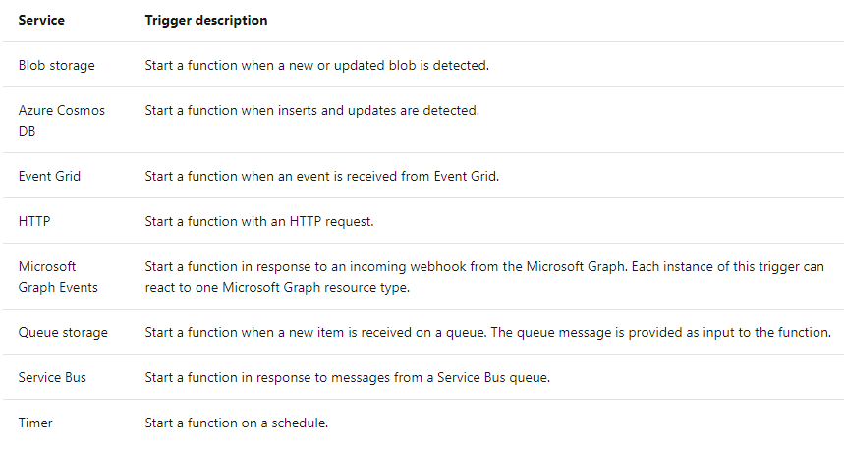

Slide 5
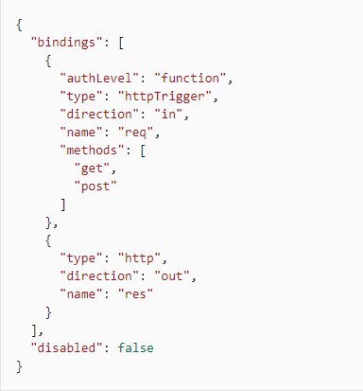
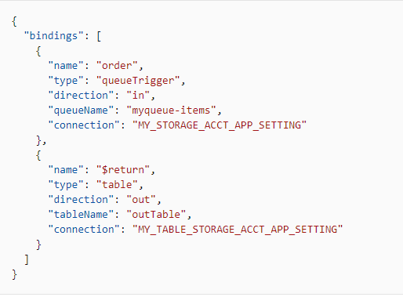
function.json

Slide 6
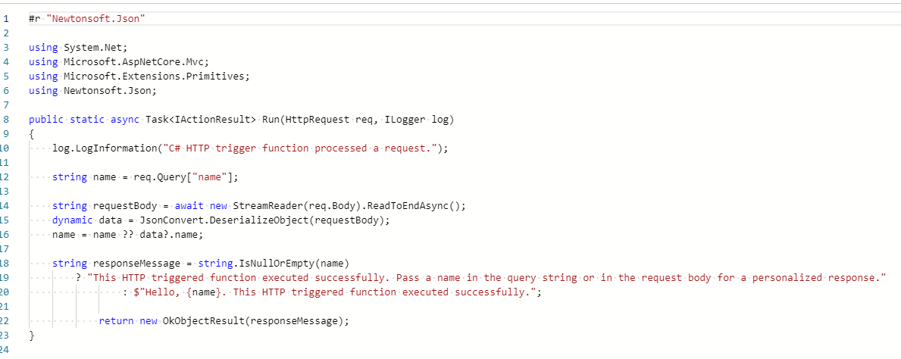

Slide 7
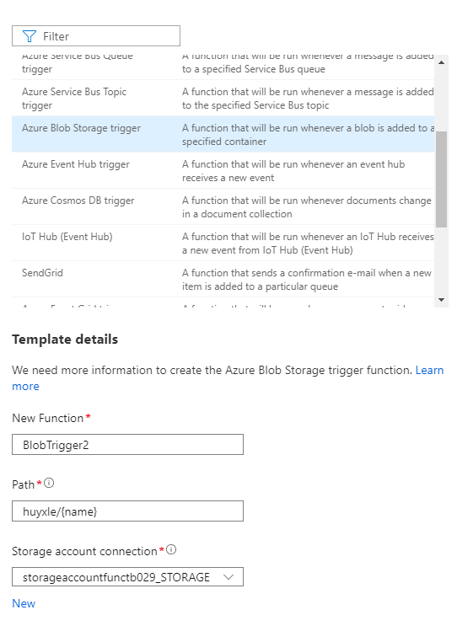
Path: huyxle/{name}: ‘huyxle’ part represents the blob container.
The second part, {name} means that every type of file will cause the trigger to invoke the function.
Storage account connection is the storage that contains ‘huyxle’ blob container.

Slide 8
Bindings are a declarative way to connect data and services to your function.
Each binding has a direction - your code reads data from input bindings and writes data to output bindings.
Each function can have zero or more bindings to manage the input and output data processed by the function.

Slide 9
The image is configuring a function with an input binding (trigger) and an output binding.
Writing a new row to Azure Table storage whenever a new message appears in Azure Queue storage.

Slide 10
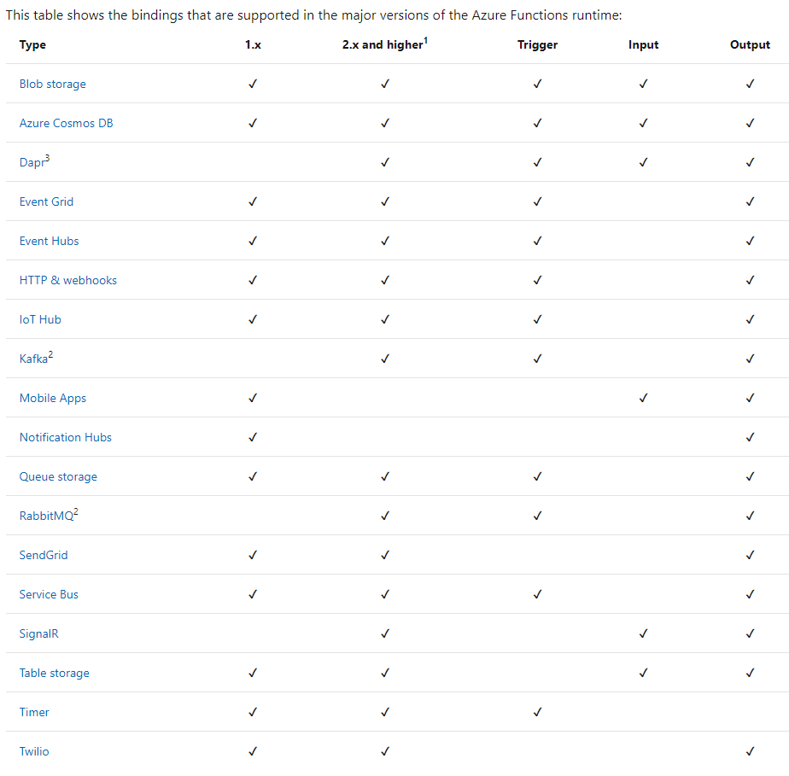
There are multiple types of input/output. However, not all types support both input and output.

Slide 11
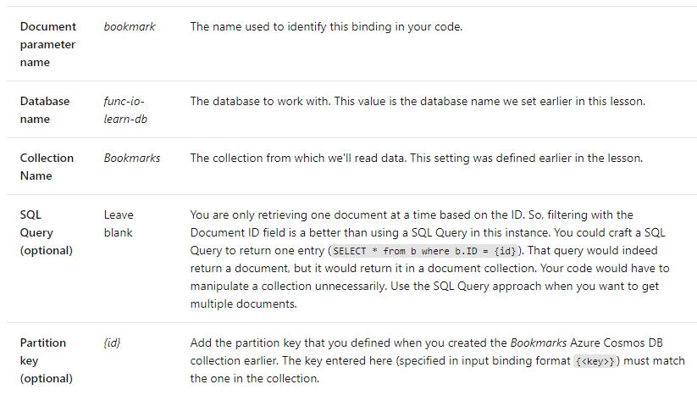
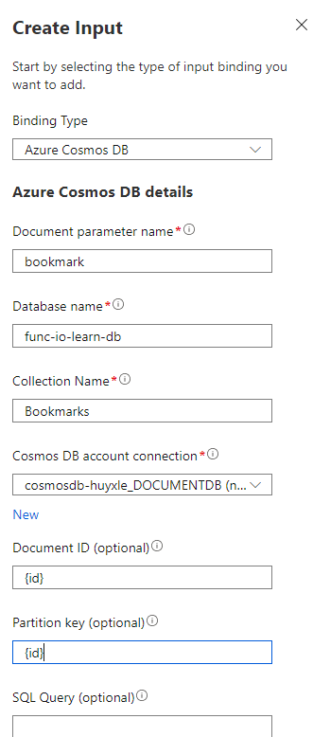
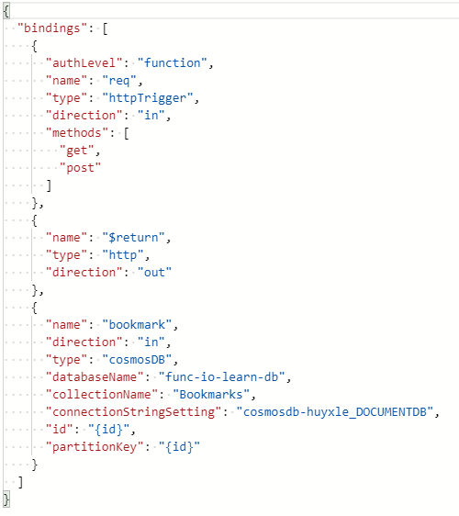
Add cosmos db input binding

Slide 12
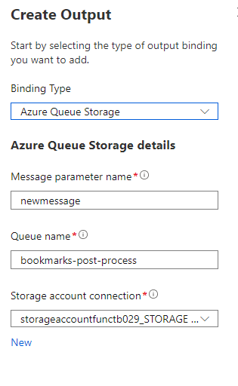
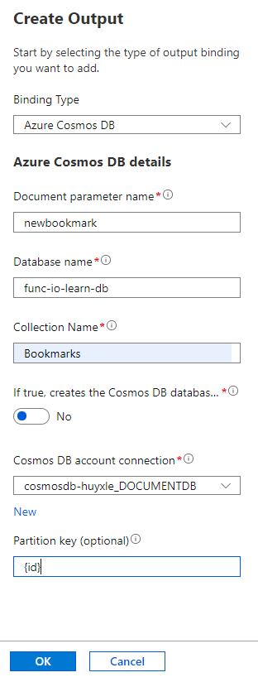
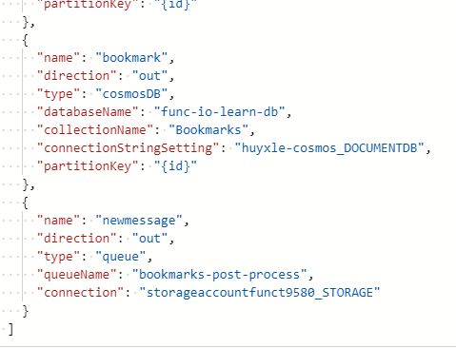
Add cosmos db and queue storage output binding

Slide 13
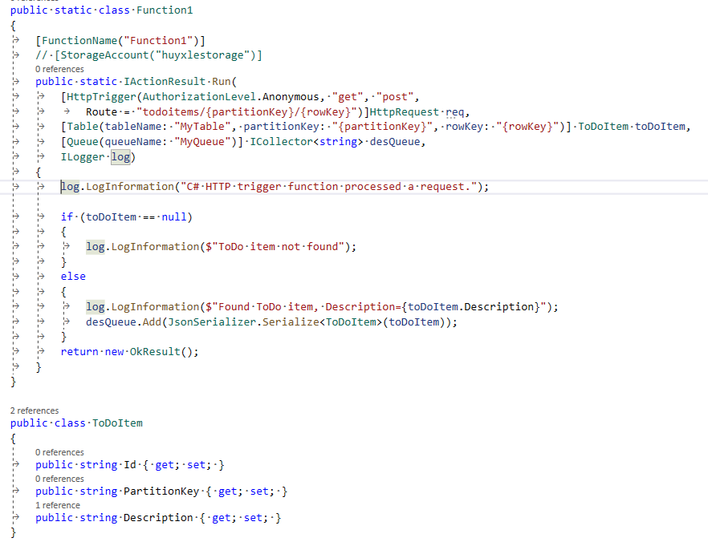
Azure function in VS2020 with HttpTrigger, TableStorage input bindinds and QueueStorage output binding.

Slide 14

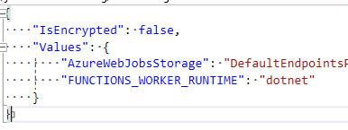
First, install two packages.
Second, to debug the code, replace the storage connection string at local.settings.json

Slide 15
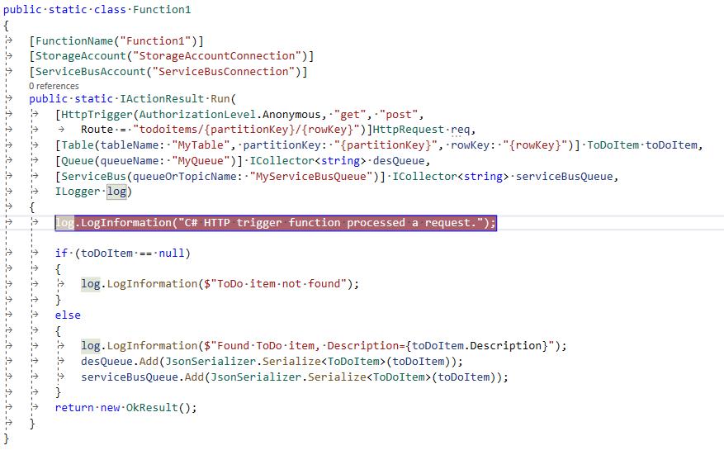
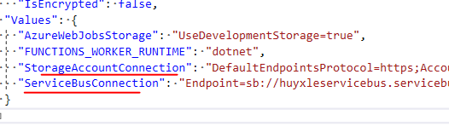
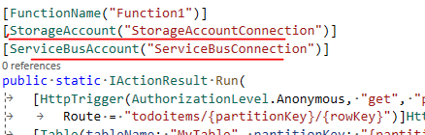
Add one more Service Bus Queue output binding.
Config two connection strings

